Slide 1




2019
INFO 802
Master Advanced Mechatronics
Luc Marechal
Introduction
Course 2

Slide 2



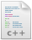
Create first node Hello World (C++)
with roscpp (C++ Client Library)
ROS main header file include
#include <ros/ros.h>
int main(int argc, char** argv)
{
ros::init(argc, argv, "hello_world");
ros::NodeHandle nodeHandle;
ros::Rate loopRate(10);
unsigned int count =0;
while (ros::ok()) {
ROS_INFO_STREAM("Hello World " << count);
ros::spinOnce();
looprate.sleep();
count++;
}
return 0;
}
Create the node
> cd ~/catkin_ws/src/beginner_tutorials/src
> sudo gedit hello_cpp.cpp
beginner_tutorials
CMakeLists.txt
Package.xml
src
hello_cpp.cpp

Slide 3
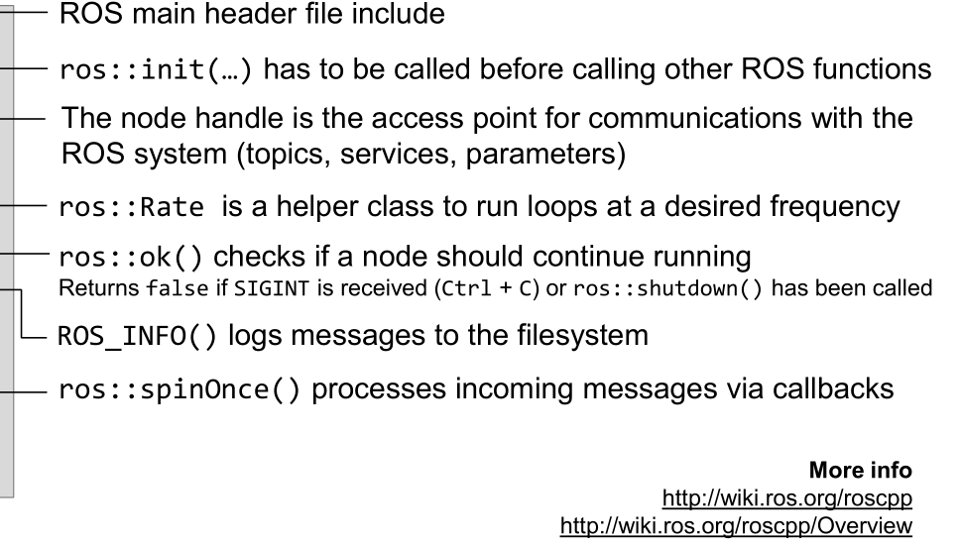
Create first node Hello World
with roscpp (C++ Client Library)
#include <ros/ros.h>
int main(int argc, char** argv)
{
ros::init(argc, argv, "hello_world");
ros::NodeHandle nodeHandle;
ros::Rate loopRate(10);
unsigned int count =0;
while (ros::ok()) {
ROS_INFO_STREAM("Hello World " << count);
ros::spinOnce();
looprate.sleep();
count++;
}
return 0;
}

Slide 4
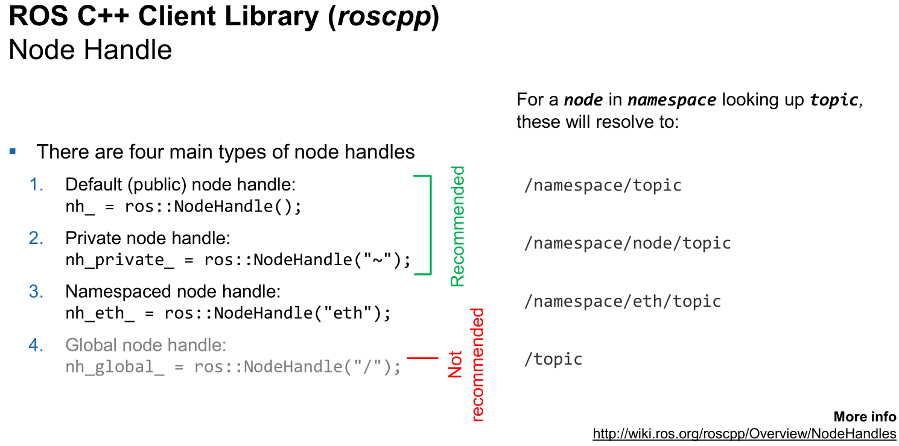

Slide 5
Building first node Hello World (C++)
Customizing CMakeLists.txt
cmake_minimum_required(VERSION 2.8.3)
project(beginner_tutorials)
## Find catkin macros and libraries
find_package(catkin REQUIRED COMPONENTS roscpp rospy std_msgs)
## Declare ROS messages and services
# add_message_files(FILES Message1.msg Message2.msg)
# add_service_files(FILES Service1.srv Service2.srv)
## Generate added messages and services
# generate_messages(DEPENDENCIES std_msgs)
## Declare catkin package
catkin_package()
## Specify additional locations of header files
include_directories(${catkin_INCLUDE_DIRS})
## Declare a cpp executable
add_executable(hello_cpp src/hello_cpp.cpp)
## Specify libraries to link a library or executable target against
target_link_libraries(hello_cpp ${catkin_LIBRARIES})
Before building your node, you should modify the CMakeLists.txt in the package
beginner_tutorials
CMakeLists.txt
Package.xml
src
hello_cpp.cpp
specifies the executable to be created after the build
links libraries and executables

Slide 6
Building first node Hello World (C++)
Customizing package.xml
<?xml version="1.0"?>
<package format="2">
<name>beginner_tutorials</name>
<version>0.1.0</version>
<description>The beginner_tutorials package</description>
<maintainer email=“luc@univ-smb.fr">Luc Mare</maintainer>
<license>BSD</license>
<url type="website">http://wiki.ros.org/beginner_tutorials</url>
<author email=“luc@univ-smb.fr">Luc Marechal</author>
<buildtool_depend>catkin</buildtool_depend>
<build_depend>roscpp</build_depend>
<build_depend>rospy</build_depend>
<build_depend>std_msgs</build_depend>
<exec_depend>roscpp</exec_depend>
<exec_depend>rospy</exec_depend>
<exec_depend>std_msgs</exec_depend>
</package>
Before building your node, you should modify the generated package.xml in the package
Beginner_tutorials
CMakeLists.txt
Package.xml
src
hello_cpp.cpp

Slide 7
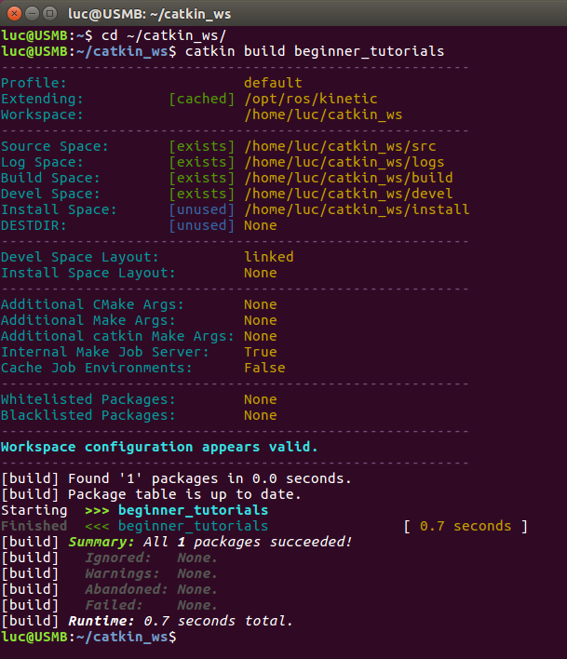
Building first node Hello World (C++)
Build package
> cd ~/catkin_ws
> catkin_make beginner_tutorials
Make sure you have sourced your workspace's setup.bash file
> cd ~/catkin_ws
> source ./devel/setup.bash
Run your node
> rosrun beginner_tutorials hello_cpp

Slide 8
Create first node Hello World (Python)
with rospy (Python Client Library)
This is the shebang. It lets the OS know that this is a Python file, and that it should be passed to the Python interpreter
#!/usr/bin/env python
# -*- coding utf-8 -*-
__author__ = "Luc Marechal"
__copyright__ = "The Hello World Project copyright"
__credits__ = “myself"
__license__ = "GPL"
__version__ = "0.0.1"
__maintainer__ = "Luc Marechal"
__email__ = "luc@univ-smb.fr"
__status__ = "Development"
import rospy
rospy.init_node(‘hello_python’)
rate = rospy.Rate(10)
while not rospy.is_shutdown():
print “Hello World”
rate.sleep()
Create the node
> cd ~/catkin_ws/src/beginner_tutorials/scripts
> sudo gedit hello_python.py
beginner_tutorials
CMakeLists.txt
Package.xml
scripts
hello_python.py

Slide 9

Building first node Hello World (Python)
with rospy (Python Client Library)
Make the file executable
> chmod +x hello_python.py
Give execution permissions to the file
Make sure you have sourced your workspace's setup.bash file
> cd ~/catkin_ws
> source ./devel/setup.bash
Run your node
> rosrun beginner_tutorials hello_python.py
Extension needed
http://www2.ece.ohio-state.edu/~zhang/RoboticsClass/docs/ECE5463_ROSTutorialLecture1.pdf

Slide 10


Create Nodes Summary
Create your .cpp file in /src folder
Customize CMakeLists.txt and package.xml files
Build the package which contains the node
Source your workspace
Run your node
Create your .py file in /scripts folder
Make the file executable
Source your workspace
Run your node with the .py extention
CMakeLists.txt
CMakeLists.txt
Package
Package
Package.xml
Package.xml
Node.cpp
Node.py
src
scripts

Slide 11
Creating a Publisher and a Subscriber Node (C++)
Writing the publisher Node
#include "ros/ros.h"
#include "std_msgs/Int32.h"
#include <iostream>
int main(int argc, char **argv)
{
ros::init(argc, argv,"First_Publisher_Node");
ros::NodeHandle node_obj;
ros::Publisher number_publisher = node_obj.advertise<std_msgs::Int32>("numbers",10);
ros::Rate loop_rate(10);
int number_count = 0;
while (ros::ok())
{
std_msgs::Int32 msg;
msg.data = number_count;
ROS_INFO("%d",msg.data);
number_publisher.publish(msg);
ros::spinOnce();
loop_rate.sleep();
++number_count;
}
return 0;
}
This node will publish an integer value on a topic called numbers
Edit a cpp file
> cd ~/catkin_ws/beginner_tutorials/src
> gedit First_Publisher_Node.cpp
beginner_tutorials
CMakeLists.txt
Package.xml
src
First_Publisher_Node.cpp

Slide 12
Creating a Publisher and a Subscriber Node (C++)
Examining the publisher Node
#include "ros/ros.h"
#include "std_msgs/Int32.h"
#include <iostream>
int main(int argc, char **argv)
{
ros::init(argc, argv,"First_Publisher_Node");
ros::NodeHandle node_obj;
ros::Publisher number_publisher = node_obj.advertise<std_msgs::Int32>("numbers",10);
ros::Rate loop_rate(10);
int number_count = 0;
while (ros::ok())
{
std_msgs::Int32 msg;
msg.data = number_count;
ROS_INFO("%d",msg.data);
number_publisher.publish(msg);
ros::spinOnce();
loop_rate.sleep();
++number_count;
}
return 0;
}
Includes all the headers necessary to use the most comon public pieces of ROS system.
We will send an integer value, so we need to include this header. Standard message definition for integer datatype.
Initialize ROS. Has to be called before other ROS functions. Specifies the name of our node (must be unique in a running system).
The Nodehandle object is the access for communication with the ROS system.
Tell the master that we are going to be publishing a message of type Int32 on the topic my_numbers.
ros::Rate is a helper class to run loops a desired frequency (here 10 Hz).

Slide 13
Creating a Publisher and a Subscriber Node (C++)
Examining the publisher Node
#include "ros/ros.h"
#include "std_msgs/Int32.h"
#include <iostream>
int main(int argc, char **argv)
{
ros::init(argc, argv,"First_Publisher_Node");
ros::NodeHandle node_obj;
ros::Publisher number_publisher = node_obj.advertise<std_msgs::Int32>("numbers",10);
ros::Rate loop_rate(10);
int number_count = 0;
while (ros::ok())
{
std_msgs::Int32 msg;
msg.data = number_count;
ROS_INFO("%d",msg.data);
number_publisher.publish(msg);
ros::spinOnce();
loop_rate.sleep();
++number_count;
}
return 0;
}
ros::ok() checks if a node should continue running
Returns false if SIGINT is received (Ctrl + C) or ros::shutdown() has been called
This is an infinite while loop, and it quits when we press Ctrl + C. The ros::ok() function returns zero when there is an interrupt; this can terminate this while loop
Creates an integer ROS message, and the second line assigns an integer value to the message. Here, data is the field name of the msg object:
This will print the message data. This line is used to log the ROS information.
Publish the message to the topics numbers. Broadcast the message to anyone who is connected
ROS::spinOnce() processes incoming messages via callbacks

Slide 14
Creating a Publisher and a Subscriber Node (C++)
Writing the subscriber Node
This node will subscribe to an integer value on a topic called numbers
Edit a cpp file
#include "ros/ros.h"
#include "std_msgs/Int32.h"
#include <iostream>
void number_callback(const std_msgs::Int32::ConstPtr& msg) {
ROS_INFO("Received [%d]",msg->data);
}
int main(int argc, char **argv) {
ros::init(argc, argv,"First_Subscriber_Node");
ros::NodeHandle node_obj;
ros::Subscriber number_subscriber =
node_obj.subscribe("numbers",10,number_callback);
ros::spin();
return 0;
}
> cd ~/catkin_ws/beginner_tutorials/src
> gedit First_Subscriber_Node.cpp
beginner_tutorials
CMakeLists.txt
Package.xml
src
First_Subscriber_Node.cpp

Slide 15
Creating a Publisher and a Subscriber Node (C++)
Examining the subscriber Node
#include "ros/ros.h"
#include "std_msgs/Int32.h"
#include <iostream>
void number_callback(const std_msgs::Int32::ConstPtr& msg) {
ROS_INFO("Received [%d]",msg->data);
}
int main(int argc, char **argv) {
ros::init(argc, argv,"First_Subscriber_Node");
ros::NodeHandle node_obj;
ros::Subscriber number_subscriber =
node_obj.subscribe("numbers",10,number_callback);
ros::spin();
return 0;
}
This is a callback function that will execute whenever a data comes to the /numbers
topic. Whenever a data reaches this topic, the function will call and extract the value and print it on the console.
Subscribe to the numbers topic with the master. ROS will call the number_callback() function whenever a new message arrives. The 2nd argument is the queue size, in case we are not able to process messages fast enough. In this case, if the queue reaches 10 messages, we will start throwing away old messages as new ones arrive.
ros::spin() is an infinite loop in which the node will wait in this step. The code will calling message callbacks as fast as possible. The node will quit only when we press the Ctrl+ C key.

Slide 16
Creating a Publisher and a Subscriber Node (C++)
Building the nodes
This node will publish an integer value on a topic called numbers
Edit a cpp file
> cd ~/catkin_ws/beginner_tutorials/src
> gedit First_Publisher_Node.cpp

Slide 17
Building Publisher and a Subscriber Node (C++)
Building the nodes
Before building your node, you should modify the CMakeLists.txt in the package
…
## Declare a cpp executable
add_executable(First_Publisher_Node src/First_Publisher_Node.cpp)
add_executable(First_Subscriber_Node src/First_Subscriber_Node.cpp)
## Dependencies
add_dependencies(First_Publisher_Node beginner_tutorials_generate_messages_cpp)
add_dependencies(First_Subscriber_Node beginner_tutorials_generate_messages_cpp)
## Specify libraries to link a library or executable target against
target_link_libraries(First_Publisher_Node ${catkin_LIBRARIES})
target_link_libraries(First_Subscriber_Node ${catkin_LIBRARIES})
…
beginner_tutorials
CMakeLists.txt
Package.xml
First_Subscriber_Node.cpp
src
First_Publisher_Node.cpp
Build all pakages
> cd ~/catkin_ws
> catkin build
> source ./devel/setup.bash

Slide 18
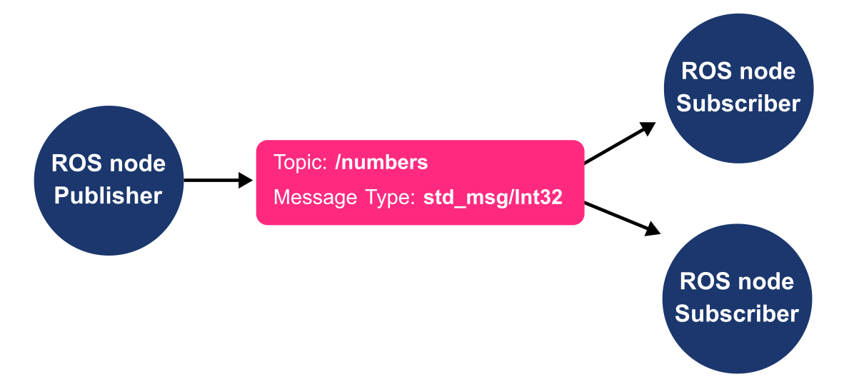
Creating a Publisher and a Subscriber Node (Python)
The publisher node publishes a message of type Int32 on the topic named numbers
The subscriber node subscribes to the topic named numbers on which the message is of type Int32

Slide 19
Creating a Publisher and a Subscriber Node (Python)
Writing the publisher Node
#!/usr/bin/env python
import rospy
from std_msgs.msg import Int32
def First_Publisher_Node():
pub = rospy.Publisher('numbers', Int32, queue_size=10)
rospy.init_node('First_Publisher_Node', anonymous=True)
rate = rospy.Rate(10) # 10hz
number_count=0
while not rospy.is_shutdown():
rospy.loginfo(number_count)
pub.publish(number_count)
rate.sleep()
number_count += 1
if __name__ == '__main__':
try:
First_Publisher_Node()
except rospy.ROSInterruptException:
pass
This node will publish an integer value on a topic called numbers
Edit a .py file in scripts folder
> cd ~/catkin_ws/beginner_tutorials/
> mkdir scripts
> cd scripts
> sudo gedit First_Publisher_Node.py
CMakeLists.txt
beginner_tutorials
Package.xml
First_Publisher_Node.py
scripts

Slide 20
Creating a Publisher and a Subscriber Node (Python)
Examining the publisher Node
#!/usr/bin/env python
import rospy
from std_msgs.msg import Int32
def First_Publisher_Node():
pub = rospy.Publisher(‘numbers', Int32, queue_size=10)
rospy.init_node('First_Publisher_Node', anonymous=True)
rate = rospy.Rate(10) # 10hz
number_count=0
while not rospy.is_shutdown():
#rospy.loginfo(number_count)
pub.publish(number_count)
rate.sleep()
number_count += 1
if __name__ == '__main__':
try:
First_Publisher_Node()
except rospy.ROSInterruptException:
pass
Every Python ROS Node will have this declaration at the top.
You need to import rospy if you are writing a ROS Node.
std_msgs.msg import is so that we can reuse the std_msgs/Int32 message type
The node is publishing to the numbers topic using the message type Int32
The queue_size argument limits the amount of queued messages if any subscriber is not receiving them fast enough.
anonymous = True ensures that your node has a unique name by adding random numbers to the end of NAME.
Helper class to run loop at desired frequency (here 10 Hz)

Slide 21
Creating a Publisher and a Subscriber Node (Python)
Examining the publisher Node
rospy.Publisher(name of the topic, message type, queue size)
queue size: this is the size of the outgoing message queue used for asynchronous publishing
More info
http://wiki.ros.org/rospy/Overview/Publishers%20and%20Subscribers

Slide 22
Creating a Publisher and a Subscriber Node (Python)
Writing the subscriber Node
This node will subscribe to an integer value on a topic called numbers
#!/usr/bin/env python
import rospy
from std_msgs.msg import Int32
def callback(data):
rospy.loginfo(rospy.get_caller_id() + "I heard %s", data.data)
def First_Subscriber_Node():
# In ROS, nodes are uniquely named. If two nodes with the same name are launched, the
# previous one is kicked off. The anonymous=True flag means that rospy will choose a
# unique name for our 'listener‘ node so that multiple listeners can run simultaneously.
rospy.init_node('First_Subscriber_Node', anonymous=True)
rospy.Subscriber('numbers', Int32, callback)
rospy.spin()
if __name__ == '__main__':
First_Subscriber_Node()
Edit a .py file in scripts folder
> cd ~/catkin_ws/beginner_tutorials/scripts
> sudo gedit First_Subscriber_Node.py
CMakeLists.txt
beginner_tutorials
Package.xml
First_Publisher_Node.py
scripts
First_Subscriber_Node.py

Slide 23
Creating a Publisher and a Subscriber Node (Python)
Examining the subscriber Node
#!/usr/bin/env python
import rospy
from std_msgs.msg import Int32
def callback(data):
rospy.loginfo(rospy.get_caller_id() + "I heard %s“, data.data)
def First_Subscriber_Node():
# In ROS, nodes are uniquely named. If two nodes with the same name are launched, the
# previous one is kicked off. The anonymous=True flag means that rospy will choose a
# unique name for our 'listener‘ node so that multiple listeners can run simultaneously.
rospy.init_node('First_Subscriber_Node', anonymous=True)
rospy.Subscriber('numbers', Int32, callback)
rospy.spin()
if __name__ == '__main__':
First_Subscriber_Node()
rospy.loginfo: logs messages to the filesystem
The anonymous=True flag tells rospy to generate a unique name for the node so that you can have multiple listener.py nodes run easily
When new messages are received, callback* is invoked with the message as the first argument.
rospy.spin(): simply keeps the node from exiting until the node has been shutdown
*Callback : function that is passed as an argument to other function

Slide 24
Creating a Publisher and a Subscriber Node (Python)
Examining the subscriber Node
rospy.Subscriber(name of the topic, message type, callback function)

Slide 25
Creating a Publisher and a Subscriber Node (Python)
Building the nodes
Make the node executable (for Python only)
> chmod +x First_Subscriber_Node.py
> chmod +x First_Publisher_Node.py
CMakeLists.txt
beginner_tutorials
Build package
(we use Cmake as the build system even for Python nodes)
Package.xml
> cd ~/catkin_ws
> catkin_make beginner_tutorials
First_Publisher_Node.py
scripts
First_Subscriber_Node.py
Make sure you have sourced your workspace's setup.bash file
> cd ~/catkin_ws
> source ./devel/setup.bash
Run your nodes
> rosrun beginner_tutorials First_Publisher_Node.py
> rosrun beginner_tutorials First_Subscriber_Node.py

Slide 26
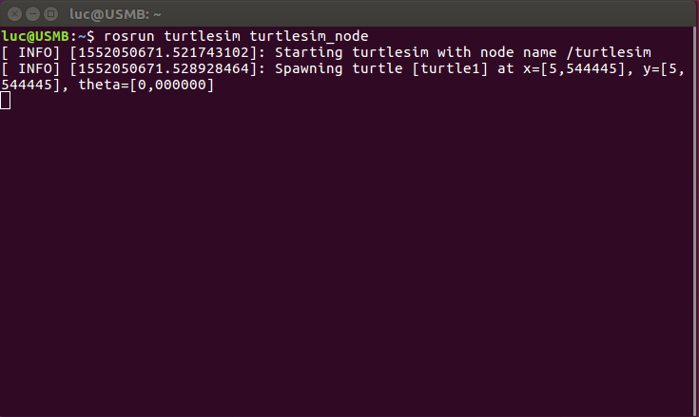
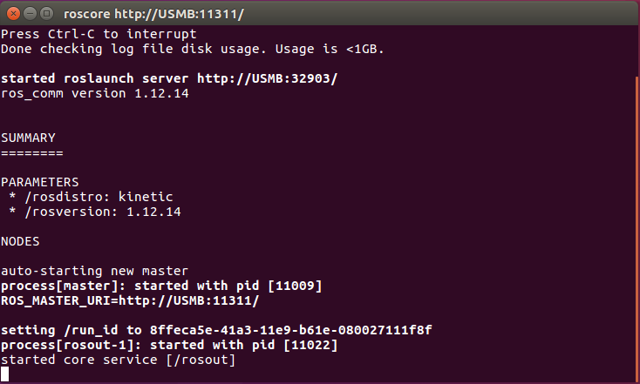
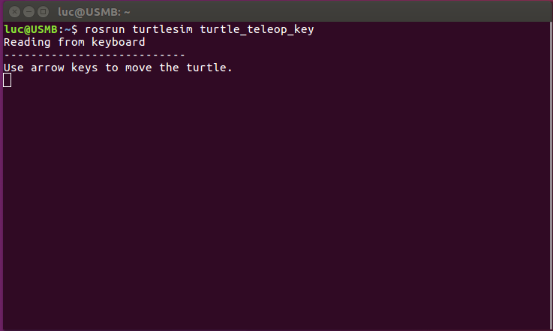
ROS Launch
Imagine a scenario in which we have to launch 10 or 20 nodes for a robot.
It will be difficult if we run each node in a terminal one by one !!!

Slide 27
ROS Launch
launch is a tool for launching multiple nodes (as well as setting parameters)
written in XML but file suffix: *.launch
the launch file needs to be located a folder named “launch” inside de package folder
If not yet running, launch automatically starts a roscore
CMakeLists.txt
beginner_tutorials
Package.xml
src
First_Publisher_Node.py
scripts
First_Subscriber_Node.py
chat.launch
Example
launch
The file chat.launch is created in order to launch the node : First_Publisher_Node.py and First_Subscriber_Node.py
More info
http://wiki.ros.org/roslaunch

Slide 28
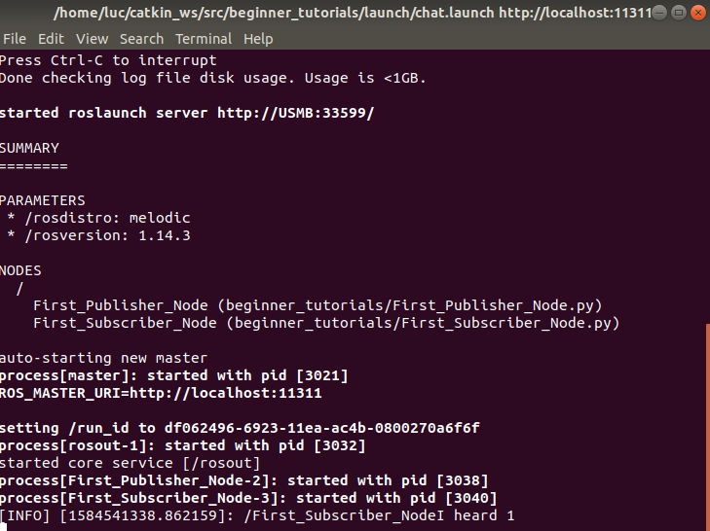
ROS Launch
Example console output for:
> roslaunch beginner_tutorials chat.launch
Start a launch file from a package with
> roslaunch [package_name] [file_name.launch]
Or browse to the folder and start a launch file with
> roslaunch [file_name.launch]
More info
http://wiki.ros.org/roslaunch

Slide 29
ROS Launch
File Structure
chat.launch
<launch>
<node name="First_Publisher_Node" pkg="beginner_tutorials" type="First_Publisher_Node.py"/>
<node name="First_Subscriber_Node" pkg="beginner_tutorials" type="First_Subscriber_Node.py" output="screen"/>
</launch>
launch: root element of the Launch files. This is an XML document, and every XML document has one
node: each <node> tag specifies a node to be launched
name: name of the node (free to choose)
pkg: package containing the node
type: the executable name
output: specifies where to output log messages (screen -> consol, log -> log file)
output=“screen” makes the ROS log messages appear on the launch terminal window

Slide 30
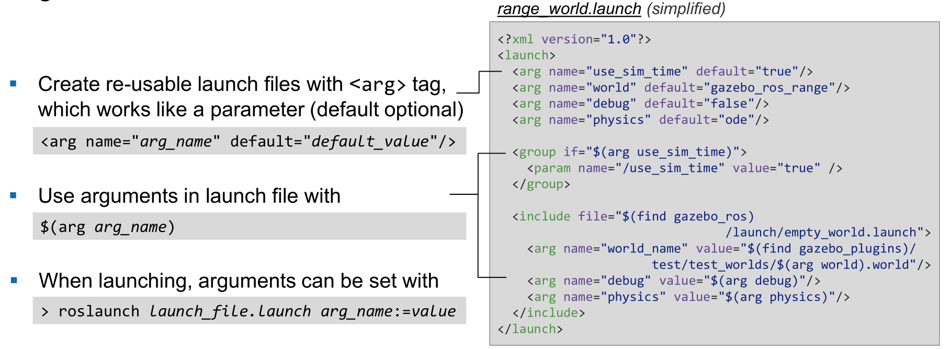
ROS Launch
Arguments

Slide 31
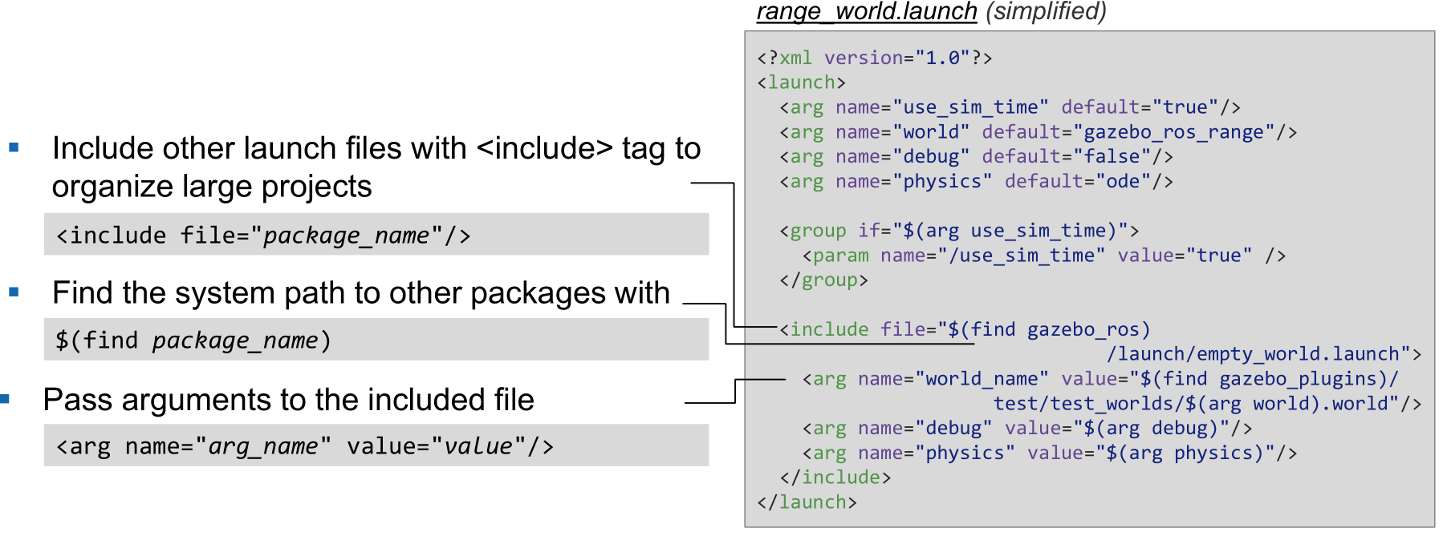
ROS Launch
Including Other Launch Files

Slide 32
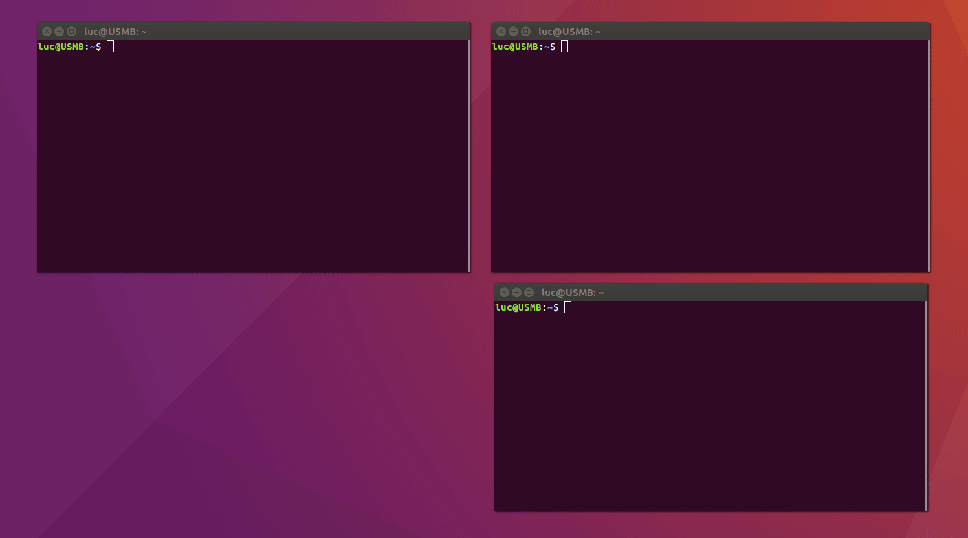
ROS Launch
Running 2 nodes from Terminal

Slide 33
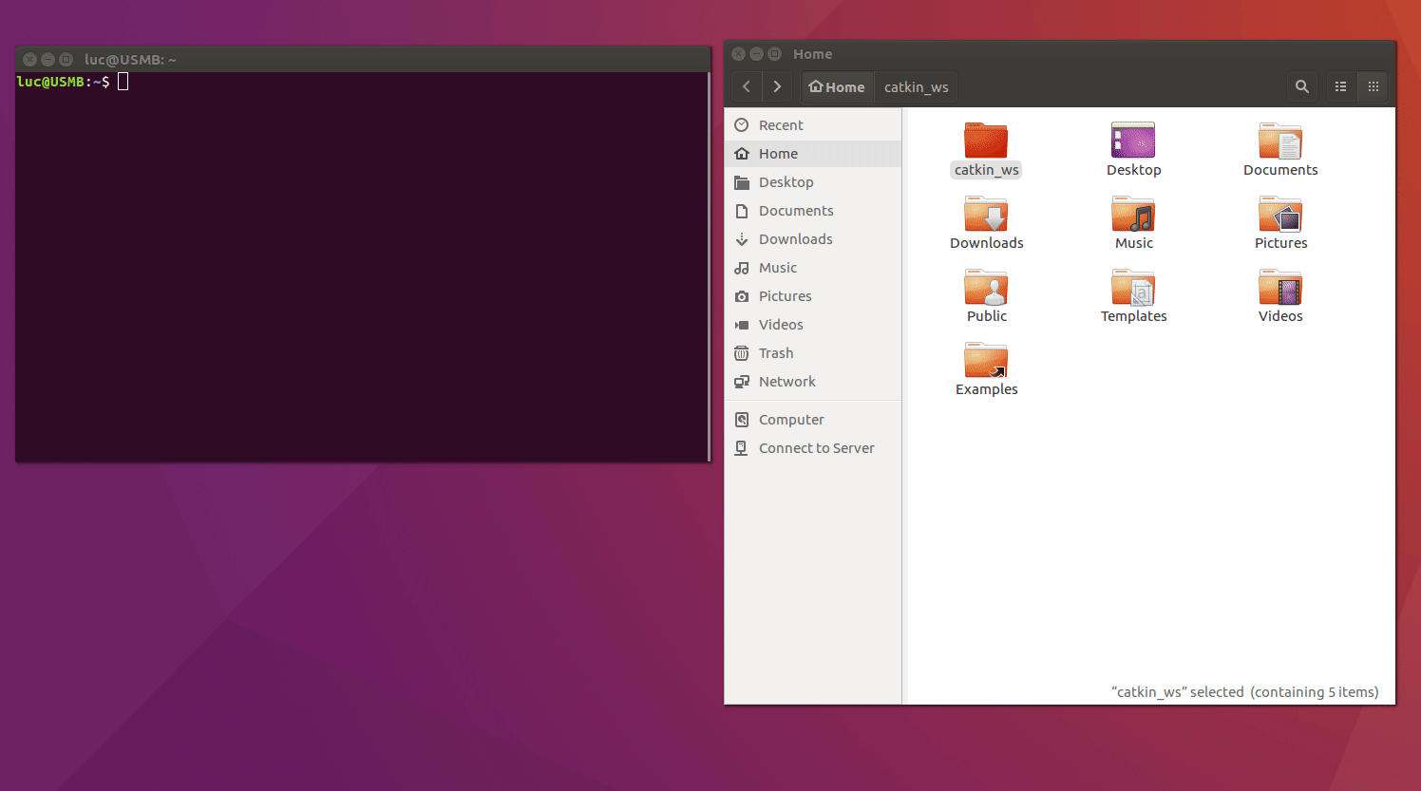
ROS Launch
Running 2 nodes with roslaunch

Slide 34




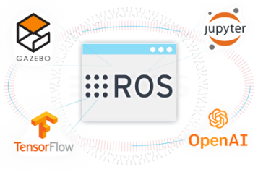







IDE for ROS
There is no best IDEs, only the IDE that works best for you !
Eclipse, Net Beans, Qt Creator: popular on Ubuntu ( )
Anaconda: nice interface ( )
but the ROS environment has to be set up and can be tedious
ROS Development Studio: only online ( )
Clion: user friendly and easy to setup ( )
RoboWare Studio: IDE especially designed for working with ROS. The installation is quite easy, and automatically detects and loads an ROS environment without additional configurations. It has different out-of-the-box features ( )

Slide 35

RoboWare Installation
Go to http://www.roboware.me/ and download the latest version of the software.
Install deb file
> cd /path/to/deb/file
> sudo dpkg -i roboware-studio_<version>_<architecture>.deb
Launch RoboWare in a console
> roboware-studio
That’s it !
More info
http://www.roboware.me

Slide 36

RoboWare Installation

Slide 37

Setup a project in Sublime3
Sublime 3 installation
> sudo add-apt-repository ppa:webupd8team/sublime- text-3
> sudo apt-get update
> sudo apt-get install sublime-text-installer
package_control installation
In Sublime : View > Show Console menu. Once open, paste the Python code
import urllib.request,os,hashlib; h = '6f4c264a24d933ce70df5dedcf1dcaee' + 'ebe013ee18cced0ef93d5f746d80ef60'; pf = 'Package Control.sublime-package'; ipp = sublime.installed_packages_path(); urllib.request.install_opener( urllib.request.build_opener( urllib.request.ProxyHandler()) ); by = urllib.request.urlopen( 'http://packagecontrol.io/' + pf.replace(' ', '%20')).read(); dh = hashlib.sha256(by).hexdigest(); print('Error validating download (got %s instead of %s), please try manual install' % (dh, h)) if dh != h else open(os.path.join( ipp, pf), 'wb' ).write(by)
More info
http://schulz-m.github.io/2016/07/12/sublime-for-catkin/

Slide 38
Setup a project in Sublime3
Setup project
Open sublime and then simply add your catkin_ws/src folder by using
Project -> Add Folder to Project, then save it as a project file in a location of your choice by Project -> Save Project as....
Build Tag definition
In SublimeType Alt + Shift + P and type install. Type ctags and put enter.
> sudo apt-get install exuberant-ctags
More info
http://schulz-m.github.io/2016/07/12/sublime-for-catkin/

Slide 39
Setup a project in Sublime3
Build catkin package from Sublime
It is very straightforward to build catkin packages using catkin tools within sublime.
Simply install the catkin builder using the package manager. You can then either run it with ctrl + shift + p and then Build with: Catkin or using Tools -> Build.
ROS Msg File Syntax
Download the syntax file from Github and copy the file into
~.config/sublime-text-3/Packages/User.
Now you can simply select ROS message definition with View -> Syntax -> Open all with current extension as....
More info
http://schulz-m.github.io/2016/07/12/sublime-for-catkin/

Slide 40
Further References
ROS Wiki
http://wiki.ros.org/
Installation
http://wiki.ros.org/ROS/Installation
Tutorials
http://wiki.ros.org/ROS/Tutorials
Available packages
http://www.ros.org/browse/
ROS Cheat Sheet
https://www.clearpathrobotics.com/ros-robot-operating-system-cheat-sheet/
https://kapeli.com/cheat_sheets/ROS.docset/
ROS Best Practices
https://github.com/leggedrobotics/ros_best_practices/wiki
ROS Package Template
https://github.com/leggedrobotics/ros_best_practices/tree/master/ros_package_template

Slide 41
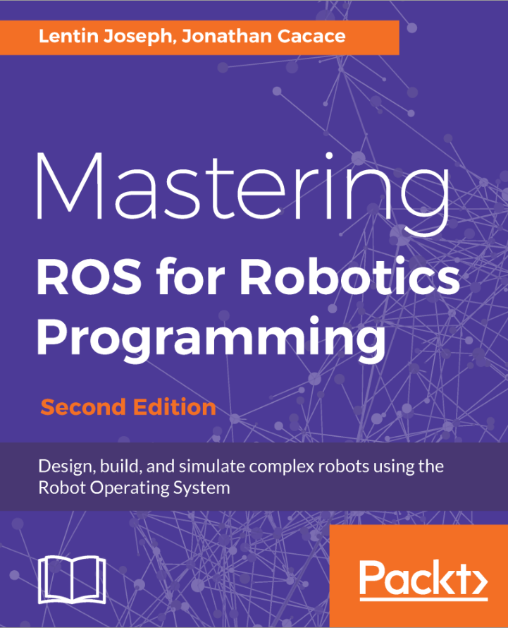
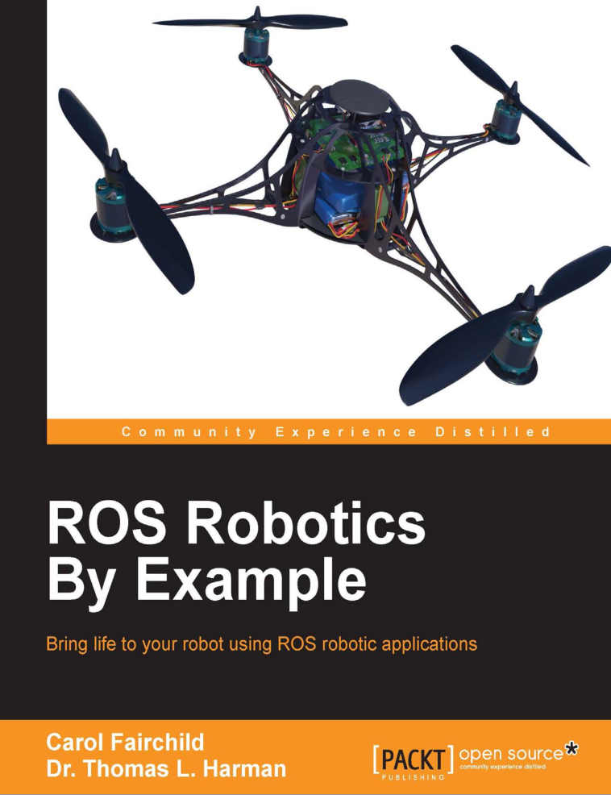
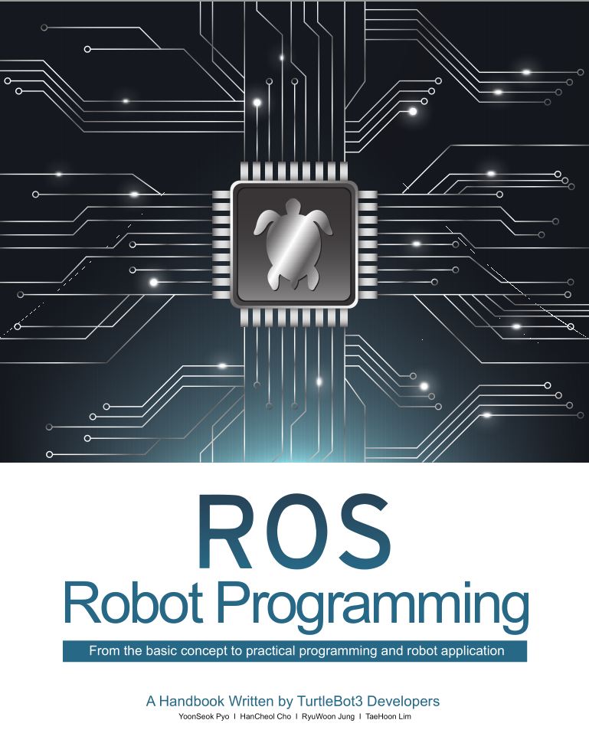
Relevant books

Slide 42

Contact Information
Université Savoie Mont Blanc
Polytech’ Annecy Chambery
Chemin de Bellevue
74940 Annecy
France
https://www.polytech.univ-savoie.fr
Lecturer
Luc Marechal (luc.marechal@univ-smb.fr)
SYMME Lab (Systems and Materials for Mechatronics)

